Slide 1
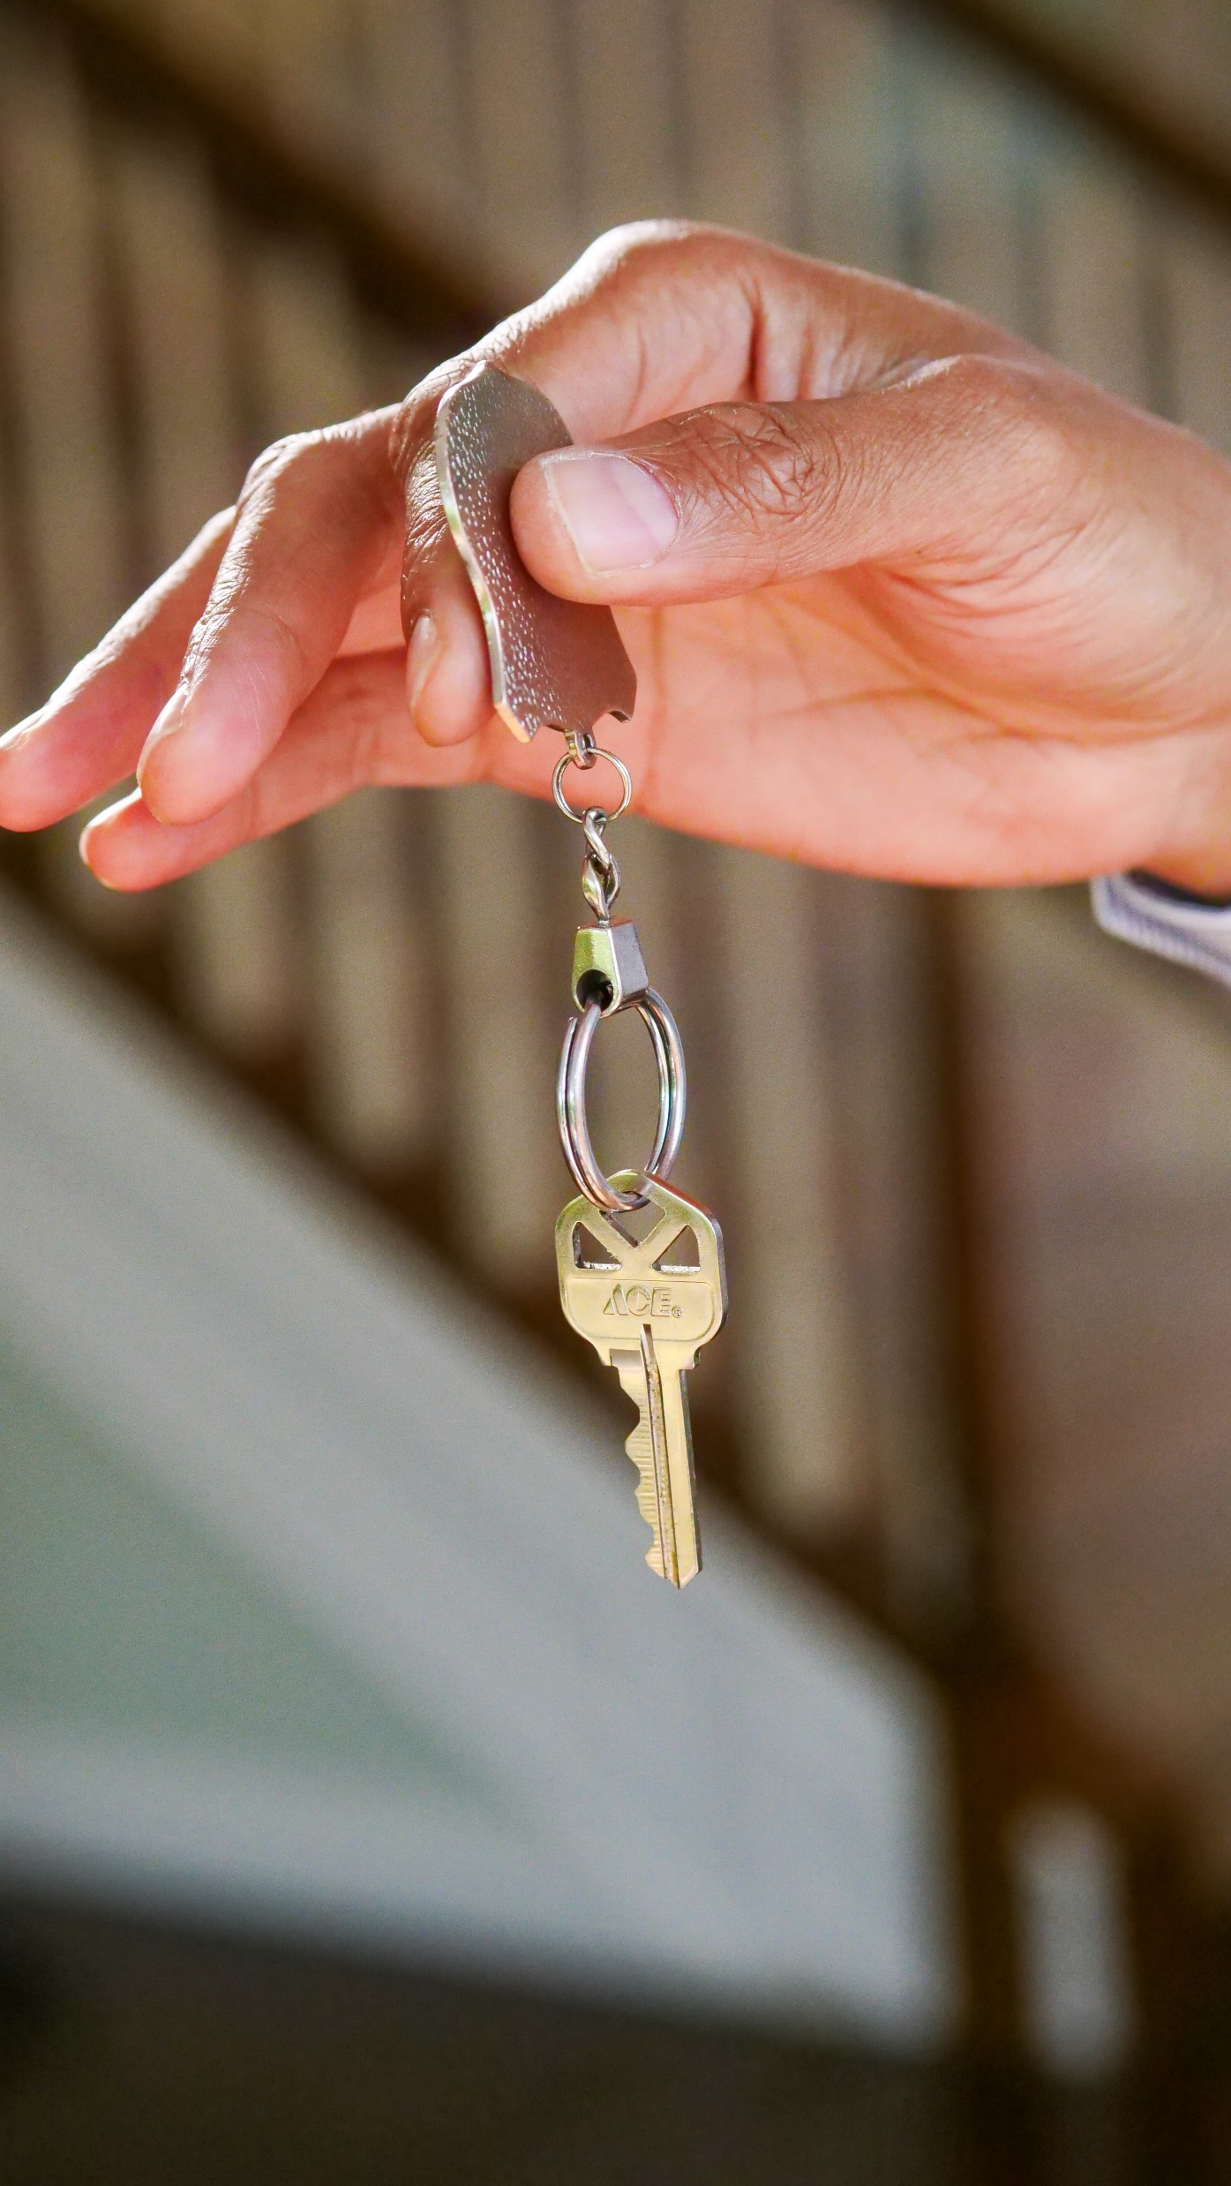
The Next Chapter
#1
‘The Acts of Jesus – Pt 2’

Slide 2
#1 - ‘The Acts of Jesus – Pt 2’
Jesus wants to continue his work through you.

Slide 3
#1 - ‘The Acts of Jesus – Pt 2’
Jesus wants to continue his work through you.
God’s kingdom is the most important thing in your life

Slide 4
#1 - ‘The Acts of Jesus – Pt 2’
Jesus wants to continue his work through you.
God’s kingdom is the most important thing in your life
You have the same power that Jesus had! 1:2-5, 8

