Slide 1
Faith that Works

Slide 2
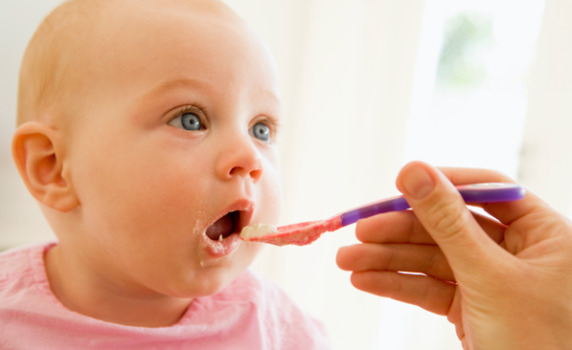

Slide 4
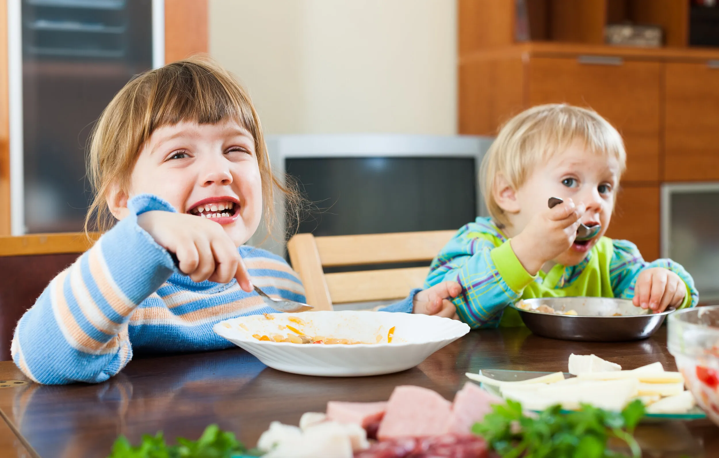

Slide 5
Saving faith is faith that is fed
The Lord’s supper - a table where the Lord feeds us

Slide 6
Saving faith is faith that is fed
The Lord’s supper - a table where the Lord feeds us
Jesus invites us to his supper. Luke 22v8 & 15

Slide 7
Saving faith is faith that is fed
The Lord’s supper - a table where the Lord feeds us
Jesus invites us to his supper. Luke 22v8 & 15
Jesus speaks to us at the table – Luke 22v19 & 20

Slide 8
‘He took the bread he gave thanks and he gave it to them saying, “This is my body given for you”’
Luke 22v19

Slide 9
‘After supper he took the cup and said “this cup is the new covenant in my blood which is poured out for you.”’
Luke 22vv20

Slide 10
Saving faith is faith that is fed
The Lord’s supper - a table where the Lord feeds us
Jesus invites us to his supper. Luke 22v8 & 15
Jesus speaks to you at the table – Luke 22v19 & 20
Jesus feeds you at his table

Slide 11
“Take and eat …”
Matthew 26v26

Slide 12
Saving faith is faith that is fed
The Lord’s supper is a table where the Lord feeds us

Slide 13
Saving faith is faith that is fed
The Lord’s supper is a table where the Lord feeds us
How does he feed us?
He gives us the bread of his completed obedience.

Slide 14
Saving faith is faith that is fed
The Lord’s supper is a table where the Lord feeds us
How does he feed us?
He gives us the bread of his completed obedience.
He gives us his blood of total forgiveness

Slide 15
“Drink of it, all of you. This is my blood of the covenant which is poured out for many for the forgiveness of sins”
Matthew 26v27

