Slide 1
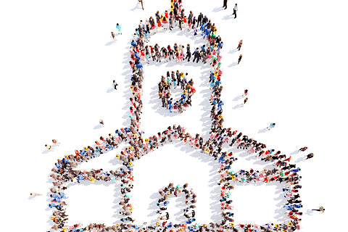
‘R E A L C H U R C H’
God’s Mission and Creation

Slide 2
‘It’s not some much the case that God has a mission for his church in the world, as that God has a church for his mission in the world’
Chris Wright

Slide 3
‘Then God said, ‘Let us make mankind in our image, in our likeness, so that they may rule over the fish in the sea and the birds in the sky, over the livestock and all the wild animals, and over all the creatures that move along the ground.’

Slide 4
So God created mankind in his own image, ....
God blessed them and said to them, ‘Be fruitful and increase in number; fill the earth and subdue it. Rule over the fish in the sea and the birds in the sky and over every living creature that moves on the ground.
Genesis 1:26-28

Slide 5
God’s Mission and Creation
God’s mission for us includes looking after creation

Slide 6
God’s Mission and Creation
God’s mission for us includes looking after creation
‘Then God said, ‘Let us make mankind in our image, in our likeness, so that they may rule …...’
Genesis 1:26

Slide 7
God’s Mission and Creation
God’s mission for us includes looking after creation
God blessed them and said to them, ‘Be fruitful and increase in number; fill the earth and subdue it. Rule over the fish …’
Genesis 1:28

Slide 8
God’s Mission and Creation
God’s mission for us includes looking after creation
‘The Lord God took the man and put him in the Garden of Eden to work it and take care of it.’
Genesis 2:15

Slide 9
God’s Mission and Creation
God’s mission for us includes looking after creation
By caring for creation we help it do what it God made it for – to glorify God. Psalm 148, Ps 19 & 146v21

Slide 10
God’s Mission and Creation
God’s mission for us includes looking after creation
By caring for creation we help it do what it God made it for – to glorify God.
Creation matters so much to God that Jesus died to rescue it! Col 1:20 & Rom 8:21

Slide 11
‘God was … through [Jesus] reconciling to himself all things - on earth and in heaven, by making peace through his blood on the cross.’
Colossians 1:20

Slide 12
‘Creation itself will be liberated from it’s bondage’.
Romans 8:21

Slide 13
God’s Mission and Creation
God’s mission for us includes looking after creation
By caring for creation we help it do what it God made it for – to glorify God.
Creation matters so much to God that Jesus died to rescue it!
God’s mission for earth is not destruction but renewal.

Slide 14
God’s Mission and Creation
To sum up:
Our mission includes caring for creation:
Because it was what we were made for
Because it has been redeemed by Jesus blood

