Slide 1
'lessons from a donkey!’
They brought the colt to Jesus … and he sat on it’
Mark 11:7

Slide 2
Lessons from a donkey
Chosen by Jesus

Slide 3
'LORD your God has chosen you out of all the peoples on the face of the earth to be his people, his treasured possession. The LORD did not set his affection on you and choose you because you were more numerous than other peoples, for you were the fewest of all peoples.

Slide 4
But it was because the LORD loved you and kept the oath he swore to your forefathers that he brought you out with a mighty hand and redeemed you from the land of slavery, from the power of Pharaoh king of Egypt.
Deuteronomy 7:6-8

Slide 5
‘You did not choose me, but I chose you and appointed you to go and bear fruit - fruit that will last.’
John 15:16

Slide 6
‘He chose us before the foundation of the world'.
Ephesians 1:4

Slide 7
'Brothers, think of what you were when you were called. Not many of you were wise by human standards; not many were influential; not many were of noble birth. But God chose the foolish things of the world to shame the wise; God chose the weak things of the world to shame the strong. He chose the lowly things of this world and the despised things - and the things that are not - to nullify the things that are'.
1 Corinthians 1:26f

Slide 8
Lessons from a donkey
Chosen by Jesus
Chosen to serve!

Slide 9
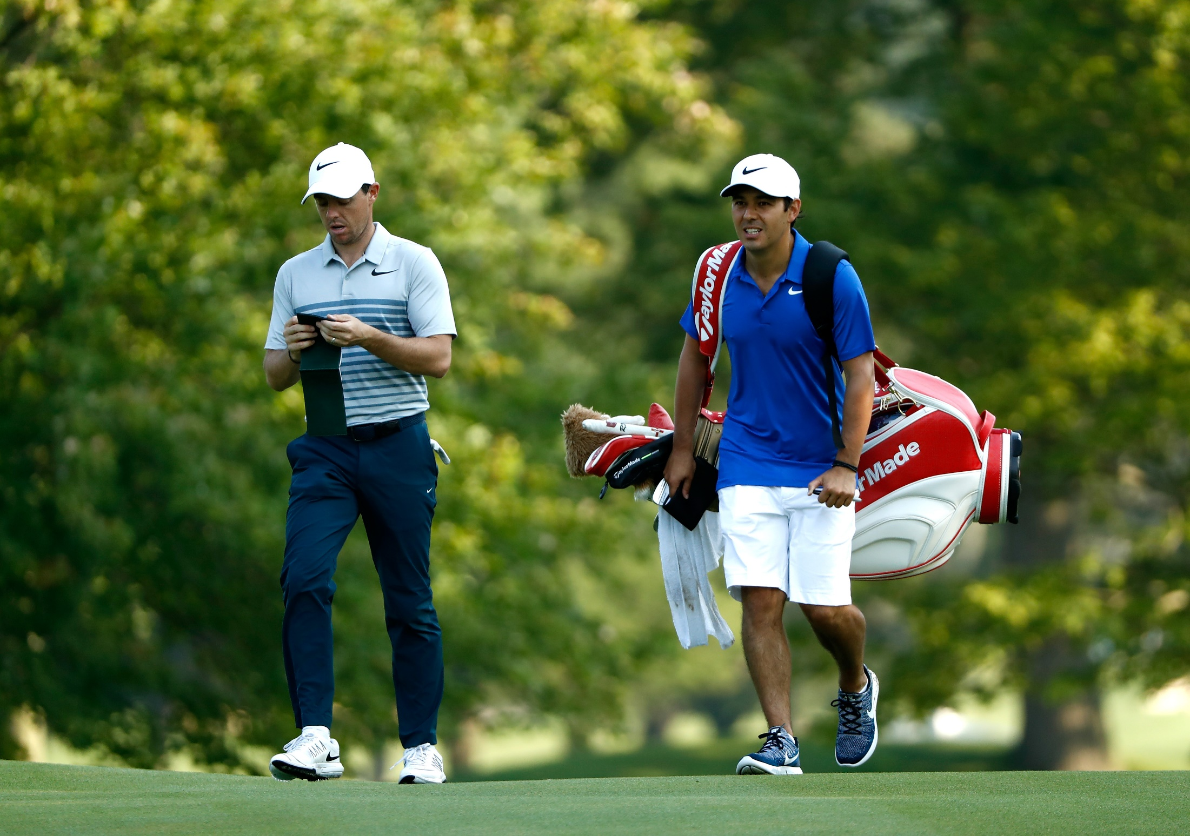

Slide 10
'They tell how you turned to God from idols to serve the living and true God'
1 Thessalonians 1:9

Slide 11
'They tell how you turned to God from idols to serve the living and true God'
1 Thessalonians 1:9

Slide 12
'We are Gods workmanship, created in Christ Jesus to do good works, which God prepared in advance for us to do'
Ephesians 2:10

Slide 13
'We are Gods workmanship, created in Christ Jesus to do good works, which God prepared in advance for us to do'
Ephesians 2:10

Slide 14
Lessons from a donkey
Chosen by Jesus
Chosen to serve!
Chosen to share in the triumph!

