Slide 1
O v e r w h e l m e d
Faith
on the
frontline

Slide 2
1.What do we do when powers overwhelm us?
‘In the Lord’s hand the king’s heart is a stream of water that he channels toward all who please him.’ Prov 21:1
Faith
on the
frontline

Slide 3
1.What do we do when powers overwhelm us?
When anxiety was great within me, your consolation brought me joy. Psa 94:19
Faith
on the
frontline

Slide 4
1.What do we do when powers overwhelm us?
God is working in our situation not outside of it
God is working through our oppressors
God is still good even when life feels bad
Faith
on the
frontline

Slide 5
2.We are all overwhelmed so we all need an overcomer
Faith
on the
frontline

Slide 6
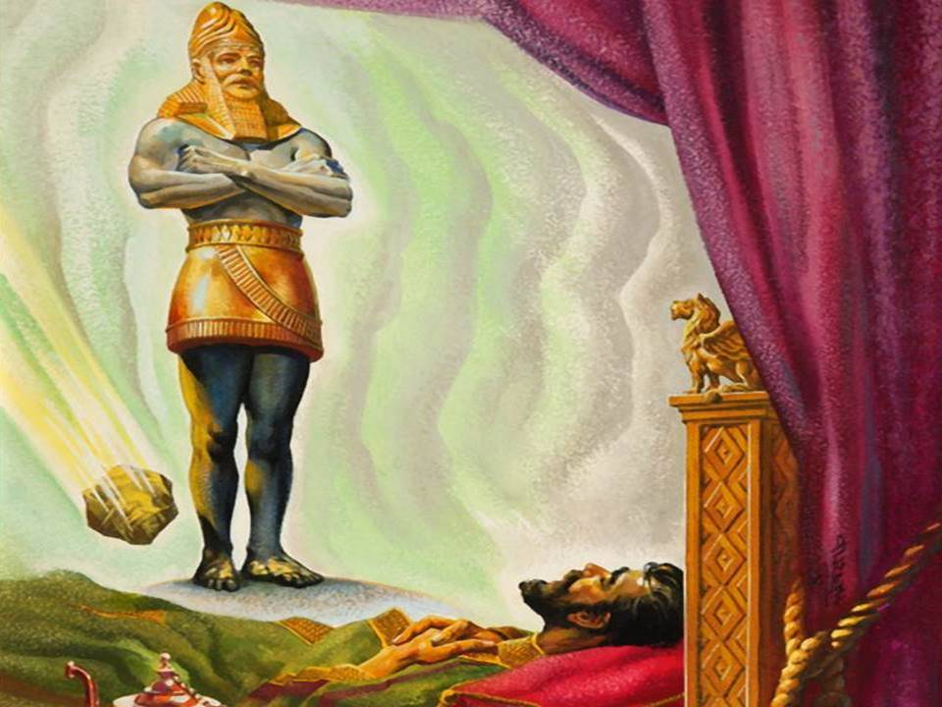
Gold: Babylon Empire
1 Pet 2:6
Silver: Medo-Persian Empire
Psa 118:22
Bronze: Greek Empire
Iron: Roman Empire
Iron&Clay: Divided/ Compromised Power
Faith
on the
frontline
Rock: Smashes all empires

Slide 7
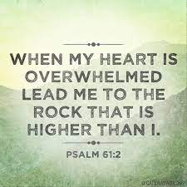
2.We are all overwhelmed so we all need an overcomer
Faith
on the
frontline

Slide 8
All that glitters is not gold!
When life feels out of control – we need the hope of Jesus (1 Pet 1:3)
When life is mysterious – we need the wisdom of Jesus (1 Cor 1:30)
When life is threatening – we need the strength of Jesus (2 Cor 12:9-10)
Faith
on the
frontline

